Slide 1

BT4222 GROUP 12
TWITTER SENTIMENT ANALYSIS
James Poh, Wei Xuan, Zishuo, Shan Shan, Haoying
COVID-19 TWEET SENTIMENT ANALYSIS

Slide 2

MISTRUST
What's happening?
PROTEST
PANIC

Slide 3

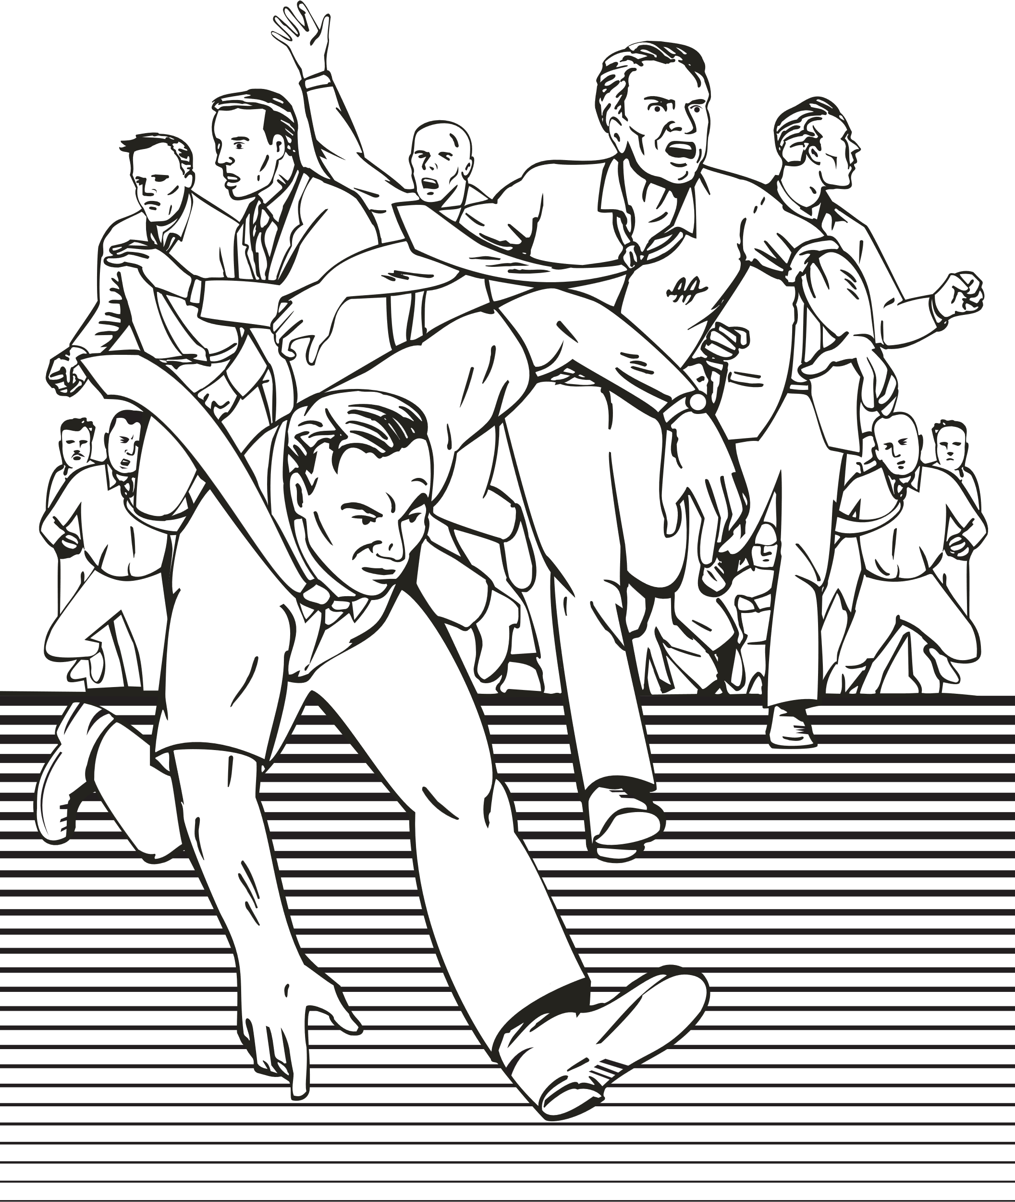
CRISIS MANAGEMENT

Slide 4
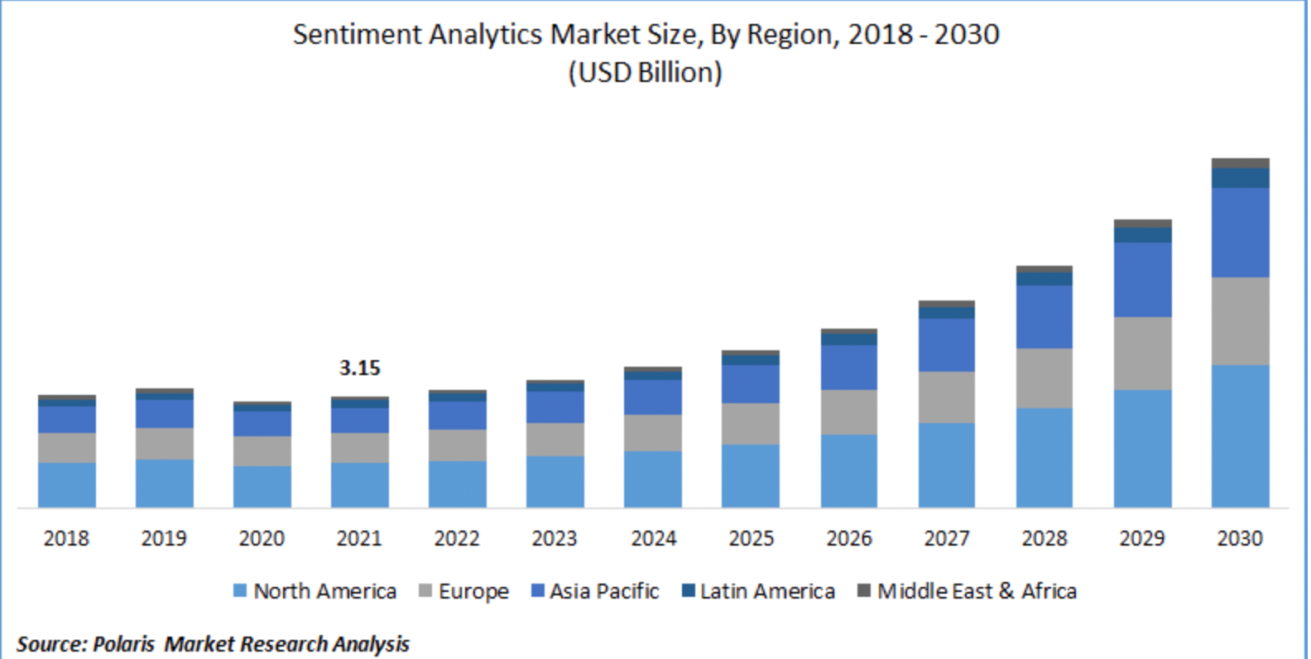

Slide 5

COVID-19 TWEETS FROM KAGGLE
LOCATION - PLACE OF TWEET
TWEET AT - TIME OF TWEET
ORIGINAL TWEET - TWEET DESCRIPTION
SENTIMENT - MANUAL SENTIMENT TAGGING DONE BY AUTHOR

Slide 6





EXPLORATORY DATA ANALYSIS
DATASET
SAMPLE TWEETS
SENTIMENT DISTRIBUTION
WORD CLOUD

Slide 7
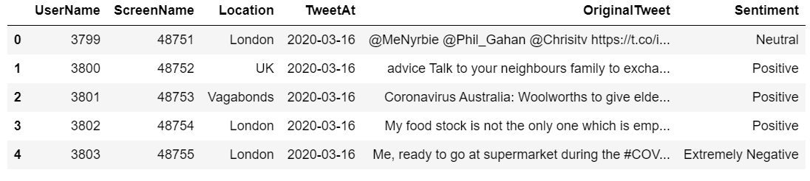

Train set: 41157 rows, 6 columns
DATASET
Test set: 3798 rows, 6 columns
DATASET
SAMPLE TWEETS
SENTIMENT DISTRIBUTION
WORD CLOUD

Slide 8




SAMPLE TWEETS
My food stock is not the only one which is empty...PLEASE, don't panic, THERE WILL BE ENOUGH FOOD FOR EVERYONE if you do not take more than you need. Stay calm, stay safe.#COVID19france #COVID_19 #COVID19 #coronavirus #confinement #Confinementotal #ConfinementGeneral https://t.co/zrlG0Z520j
Los Angeles residents are bulk buying firearms amid fears of a food shortage as continues to sweep across the 19
DATASET
SAMPLE TWEETS
SENTIMENT DISTRIBUTION
WORD CLOUD

Slide 9
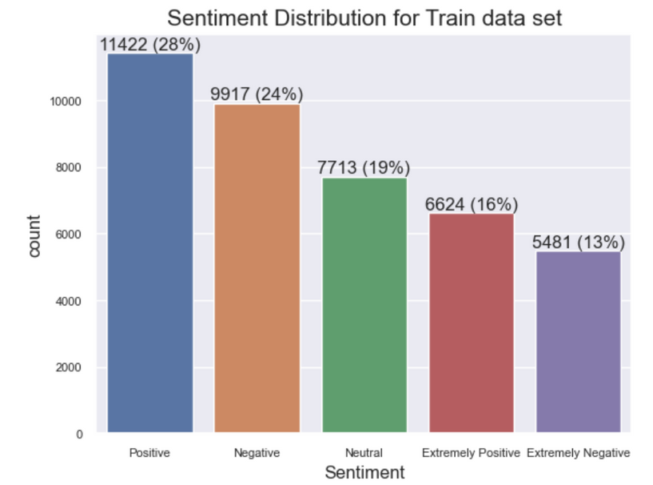
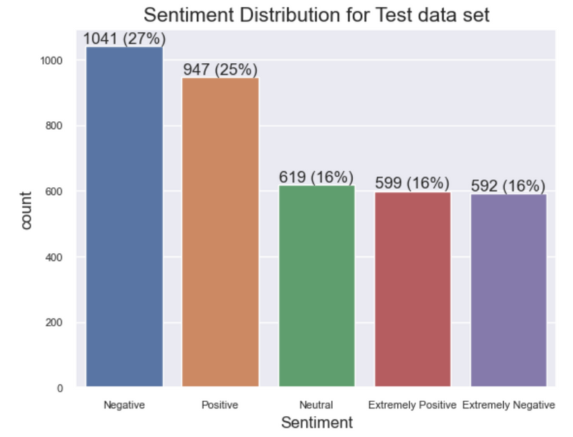
SENTIMENT DISTRIBUTION
SENTIMENT DISTRIBUTION FOR TRAIN SET
SENTIMENT DISTRIBUTION FOR TEST SET
DATASET
SAMPLE TWEETS
SENTIMENT DISTRIBUTION
WORD CLOUD

Slide 10



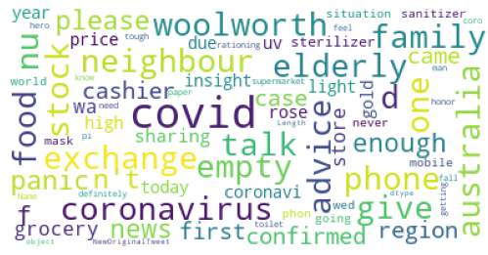
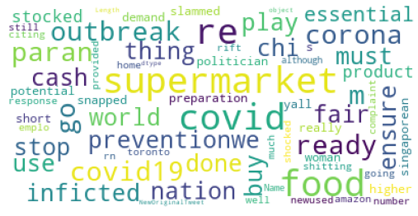
WORD CLOUDS
Positive sentiment
Negative Sentiment
DATASET
SAMPLE TWEETS
SENTIMENT DISTRIBUTION
WORD CLOUD

Slide 11

DATA CLEANING & PREPROCESSING
ORIGINAL TWEETS
DATA CLEANING
PRE-PROCESSING

Slide 12



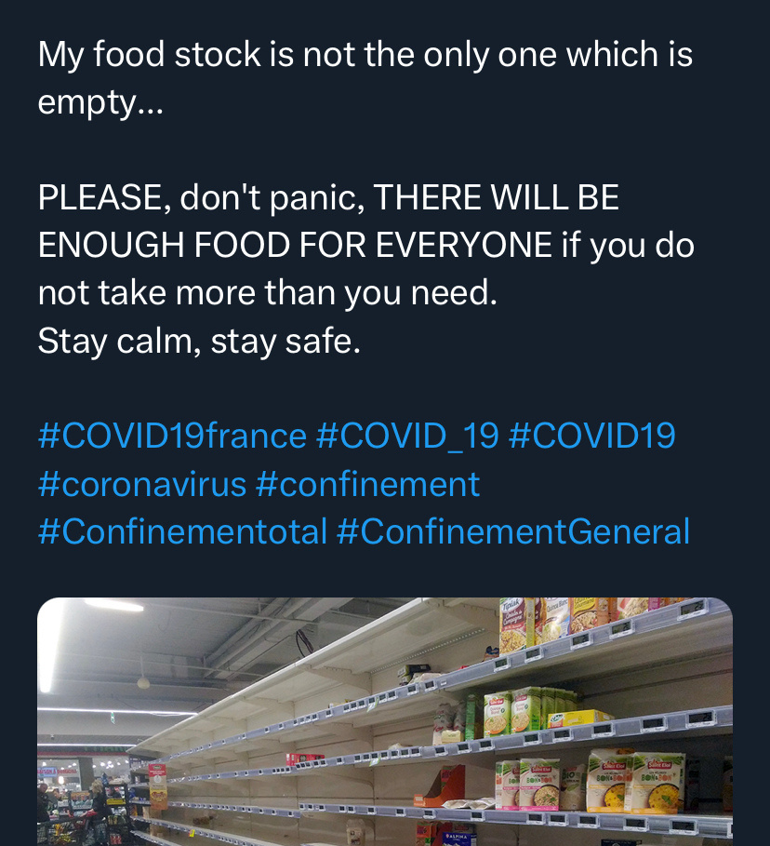


Original Tweet:
Stopwords
Punctuations: ...
Upper & Lower cases
Line breakers
Hashtags
Links to photos
ORIGINAL TWEETS
DATA CLEANING
PRE-PROCESSING

Slide 13

Original Tweet:
UTF-encodings: ' -> Â
Mentions: @ +users
Links to external contents
ORIGINAL TWEETS
DATA CLEANING
PRE-PROCESSING

Slide 14
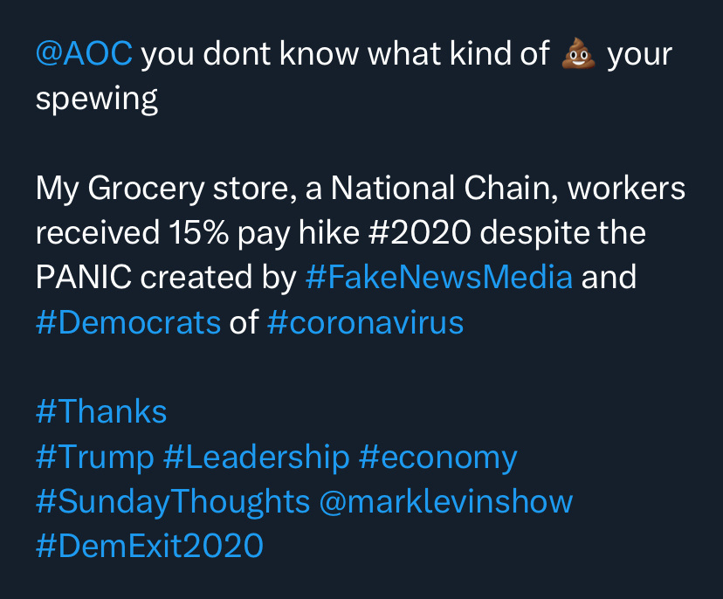
Original Tweet:
Emojis
Numbers: 15%, 2020
Special Char: #
ORIGINAL TWEETS
DATA CLEANING
PRE-PROCESSING

Slide 15

Data Cleaning:
Convert | All to lower cases
Remove | Stop words, punctuations, numbers, special characters, white-spaces and line breakers, hashtags, mentions, links, emojis, utf-encodings
Lemmatization | Reduce words to base forms
Tokenization | Break text into small units
ORIGINAL TWEETS
DATA CLEANING
PRE-PROCESSING

Slide 16
Example of Tweet
Before & After Cleaning:
My food stock is not the only one which is empty...
PLEASE, don't panic, THERE WILL BE ENOUGH FOOD FOR EVERYONE if you do not take more than you need.
Stay calm, stay safe.
#COVID19france #COVID_19 #COVID19 #coronavirus #confinement #Confinementotal #ConfinementGeneral https://t.co/zrlG0Z520j
food stock one empty please n't panic enough food everyone take need stay calm stay safe
ORIGINAL TWEETS
DATA CLEANING
PRE-PROCESSING

Slide 17

Pre-processing of Targets:
Group sentiments
from {Extremely Negative, Negative, Neutral, Positive, Extremely Positive}
to {Negative, Neutral, Positive}
Encode sentiments to numerical values
from {Negative, Neutral, Positive}
to {0, 1, 2}
ORIGINAL TWEETS
DATA CLEANING
PRE-PROCESSING

Slide 18

FEATURE ENGINEERING
TEXT ANALYSIS
SMOTE RE-SAMPLING
TF-1DF
WORD2VEC

Slide 19




TEXT ANALYSIS
Example: go supermarket like without judged
WORD COUNT
CHARACTER COUNT
SENTENCE COUNT
AVERAGE WORD LENGTH: sum of words length divided by the number of words (character count/word count)
AVERAGE SENTENCE LENGTH: sum of sentences length divided by the number of sentences (word count/sentence count)
Number of UNIQUE WORDS
RATIO of UNIQUE WORDS to TOTAL NUMBERS OF WORD
TEXT ANALYSIS
SMOTE RE-SAMPLING
TF-1DF
WORD2VEC

Slide 20
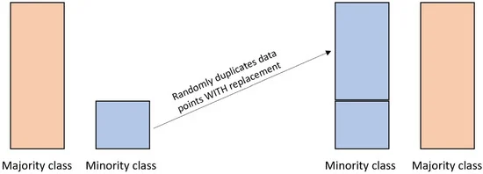
SMOTE RE-SAMPLING
Handle imbalance datasets
Duplicates and add random examples from the minority class until it is balanced with the majority class
Typically used in conjunction with a machine learning model
Helps model better recognize patterns and relationships
TEXT ANALYSIS
SMOTE RE-SAMPLING
TF-1DF
WORD2VEC

Slide 21
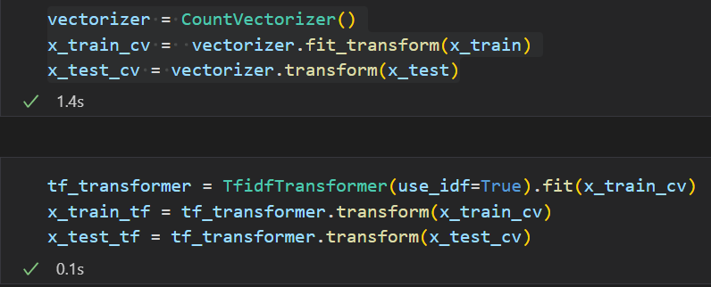
TF-IDF (TERM FREQUENCY-INVERSE DOCUMENT FREQUENCY)
TF-IDF (Max token length < 50):
Useful to identify keywords that represent sentiments
Treats all terms equally, results in irrelevant terms given too much weight
Does not consider word order
Can result in sparse data
Useful for short text documents if they contain specific keywords/phrases that are important for identifying their content
TEXT ANALYSIS
SMOTE RE-SAMPLING
TF-1DF
WORD2VEC

Slide 22
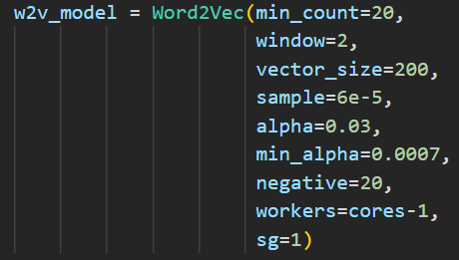
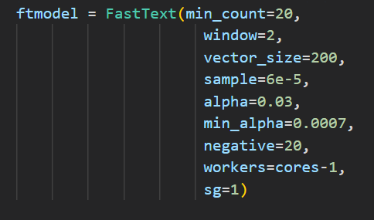
WORD2VEC
Capture semantic relationships between words and context in a document
Capture more nuanced relationships between words
Identifies words that are similar in meaning but may not appear in the same context
More effective for longer, more complex documents where sentiment is conveyed through subtle linguistic cues
TEXT ANALYSIS
SMOTE RE-SAMPLING
TF-1DF
WORD2VEC

Slide 23
MODEL EVALUATION
&
INSIGHTS
MODEL
FINE TUNING
EVALUATION SCORE
INSIGHTS
FUTURE
PLAN
Notes:
Thank you Shan Shan, I will be going through the model evaluation and insights.

Slide 24

MODEL
Model / Text-Based Features | Logistic Regression | Naive Bayes | Random Forest | Gradient Boosting | XGBoost | Adaboost | Recurrent Neural Network -LSTM | BERT | RoBERTa
TF-IDF
Word2Vec
Tokenizer
Tokenizer is used in RNN, BERT and Robert as these models rely on sequential input
MODEL
FINE TUNING
EVALUATION SCORE
INSIGHTS
FUTURE
PLAN
Notes:
To identify the most suitable model, we employed 9 different models, each trained using distinct text-based features generated through TF-IDF, Word2Vec, and Tokenization methods.
Among the models, RNN, BERT, and Robert relied solely on tokenization as they rely highly on sequential input.

Slide 25
FINE-TUNING
GridSearchCV
RandomizedSearchCV
GridSearchCV
RandomizedSearchCV
Logistic Regression
Adaboost
Gradient Boosting
XGBoost
MODEL
FINE TUNING
EVALUATION SCORE
INSIGHTS
FUTURE
PLAN
Notes:
Furthermore, to enhance model performance, we conducted fine-tuning for the following models.

Slide 26

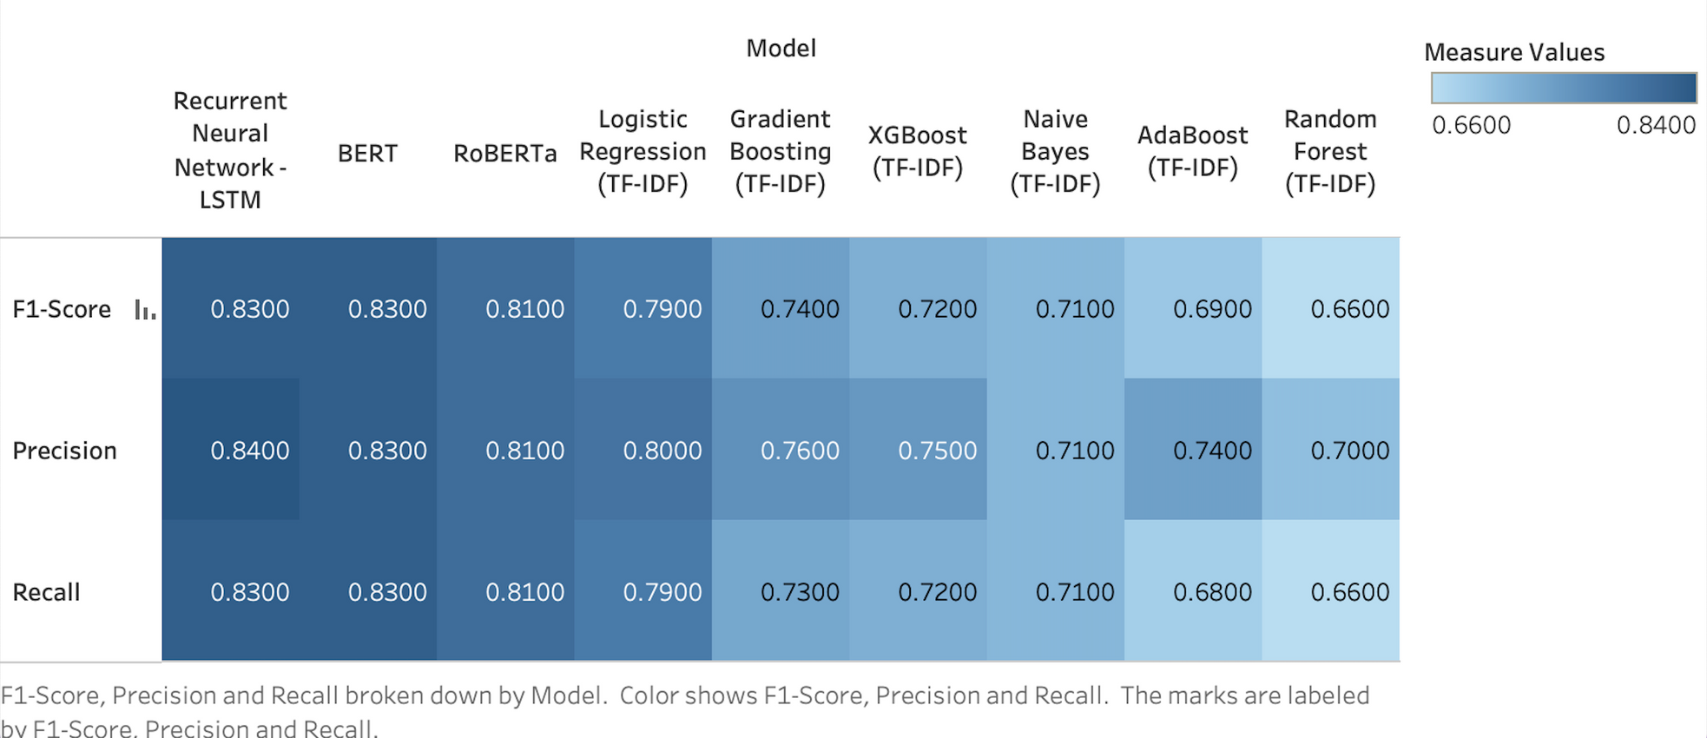

EVALUATION
All evaluation metrics are weighted average as the test dataset is imbalanced among classes
Model
/
Evaluation
Metrics
MODEL
FINE TUNING
EVALUATION SCORE
INSIGHTS
FUTURE
PLAN
Notes:
Here are the results.
We have selected the best performing model for each of the 9 types of models.
Our main criteria is the weighted average of F1 score as it takes into account both precision and recall.
The top-performing model is BERT, achieving an F1 score of 0.93.

Slide 27




TIME IS OF ESSENCE
INSIGHTS - CRISIS MANAGEMENT
TIME IS OF ESSENCE
QUICK & INFORMED DECISION-MAKING
MODEL
FINE TUNING
EVALUATION SCORE
INSIGHTS
FUTURE
PLAN
Notes:
Time is of essence during a crisis.
As such, manual tagging of every data can take a long time and also have potential human errors.
By relying on these models, we can get an accurate and fast overview of the population sentiment.
This allows the relevant authorities to make quick and informed decisions.

Slide 28
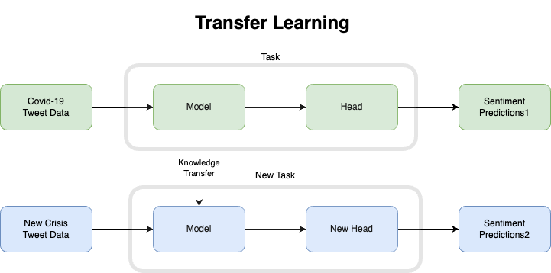
Transfer Learning
FUTURE PLAN
Transfer Learning
Update new Tweet Crisis Data
Knowledge Transfer
Fine-Tuning
Flexibility
Adaptability
MODEL
FINE TUNING
EVALUATION SCORE
INSIGHTS
FUTURE
PLAN
Notes:
In future, the model can be updated with fresh tweet data to generate ongoing predictions about public sentiment.
This enables it to adapt to potential future crises through transfer learning.
The model can be customized and fine-tuned to handle emerging crises while still retaining the knowledge learned from the COVID-19 tweet data.
In this way, the model can be made more flexible and adaptable, enabling it to handle a wide range of crises and provide valuable insights to assist decision-making by authorities.

Slide 29
THANK YOU
FOR YOUR ATTENTION
COVID-19 TWEET SENTIMENT ANALYSIS
Notes:
Thank you for your time and attention !

